Slide 1
Mantid Scientific Steering Committee
Nick Draper
12/04/2010

Slide 2
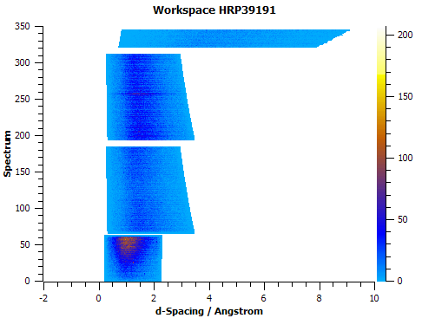
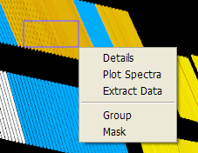
Progress over the last iteration
User interface changes
  MantidPlot Help pages
  2D contour plot improvements
    Ragged workspaces
    Axes gaps
    Accuracy
  Instrument Display
    Dynamic updates
    More Pick mode options
      Group
      Mask
      Extract
  Default Workspace in Algorithm Dialogs

Slide 3
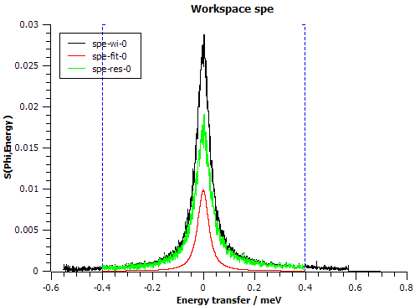
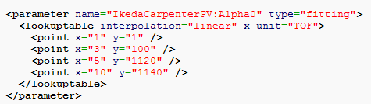
Progress over the last iteration
Curve Fitting
  Convolution of model and resolution functions
  Plot guess of sum of functions
  Instrument Parameters

Slide 4
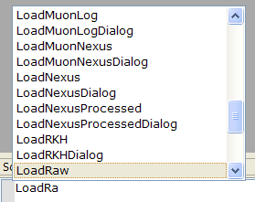
Progress over the last iteration
Python Scripting
  Reference Help Pages
  Auto complete
  Parameter tooltip functionality
Performance
  Dynamic memory Management for Mac
  No multi threading yet for Mac

Slide 5
Progress over the last iteration
SANS
  Batch Mode can now be run from a script
  Complex rebinning in Q
Excitations
  Evaluation and correction of differences from LibISIS
  ‘Homer’ analysis controllable via script
Muons
  LoadMuonNexus now seamlessly handles v1 and v2
Molecular Spectroscopy
  SofQW

Slide 6
Progress over the last iteration
General
  GenericAbsorptionCorrection
  Scale
  Distribution handling improved
    Divide
    NormaliseToMonitor
Installation
  No need to uninstall Windows version
Crashes/Bugs
  14 Notable bugs corrected.

Slide 7
Next Release
Major Items
  Monte Carlo Absorption correction
    Divergence profile
    Multiple scattering
  Finalise and complete ‘Homer’ interface
  Inelastic Convert To Energy Interface requirements
  Matlab interface
  Script repository requirements
  Single Crystal requirements
Target Date
  14th June 2010

